Slide 1

BioRubeBot
CS452 – Senior Software Engineering Capstone Project
Spring 2017

Slide 2
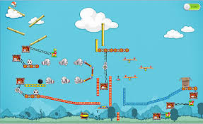
The customer’s problem…
Dr. Cline’s vision is to create a physics based game that simulates the cell signaling processes. She also wants the user to learn while playing the game. The idea came from the illustrated game below, “The Incredible Machine”, which uses physics to simulate real world movements.
Notes:
Dr. Cline started our whole project off with this statement
BioRubebot’s targeted audience is children ranging K-12.

Slide 3
Challenge to the team…
Fix major lag and performance issues.
Learn Unity in a short amount of time.
Understand the biology behind the project.
Learn to work together as a group to accomplish a shared goal.
Completing level one.
Design and implement level two.
Starting design and implementation for level three.
Notes:
DENZEL –
Fix lag by correcting code
Mention fast forward toggled incorrectly, green highlighting was wrong as well (under performance issue of first bullet point)
Some team members needed to learn unity
All had to learn the biology
Everybody had to settle in their positions and understand how their roles contributed to the project overall.
Mention g-protein did not function correctly in build we received.

Slide 4
Proposed solution
Research most efficient ways to fix lag issues
Research Unity’s documentation to better understand functionality.
Study materials provided by customer to understand the biology.
Utilize group chat services to communicate and delegate tasks.
Determine best fix actions for G-Protein, fast forward button, and various other issues with the IPAD
Work with customer to design and implement new pieces in level 2.
Notes:
Direct G-Protein fix questions to David, all IPAD questions still defer to Denzel
Explain last bullet point more in detail.

Slide 5
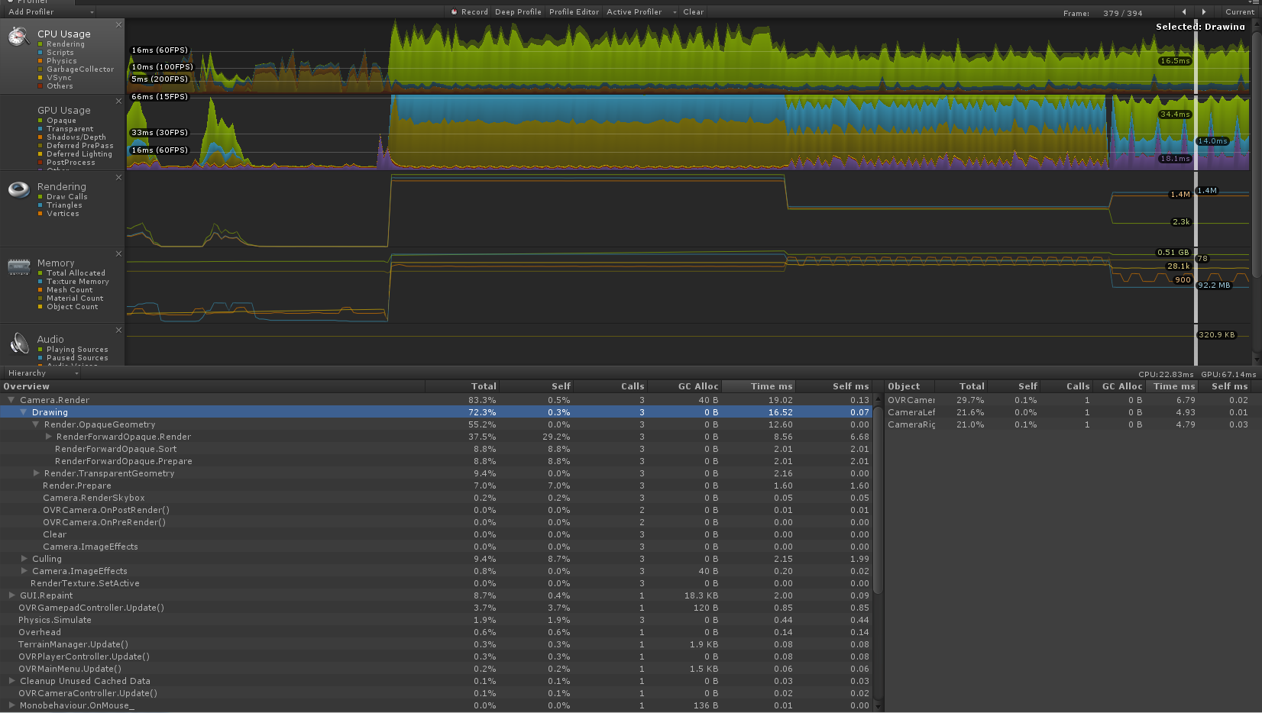
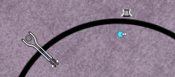
Details
Level 1
Fixed Lag & Performance Issues
Performed CPU optimization techniques to discover what function was causing the game to lag.
Refactored script to maximize performance and stop lag issues.
Fixed bug with G-Protein
G-Protein left the cell and prevented the game from being win-able
Fixed the scripts to make the g-protein stay in place when activated by the receptor.
Ensured g-protein worked on Ipad.
Fixed Fast Forward button
Changed the script to make the button toggle.
Notes:
Denzel –

Slide 6


Details
Level 2
Developed a two part receptor
Created prefabs for left and right side to the original receptor.
Added components to the new prefabs and attached behavior scripts.
Changed Menu Option to suite new prefabs
Imported prefabs into the menu.
Removed unused items from menu.
Fixed issues on IPad
Fixed tree hierarchy.
Fixed scripts for IPad functionality.
Notes:
Denzel – New prefabs for level 2
(Menu)-Removed original single receptor and placed new parts in menu
Lisa designed
David – (Unity) Behavior scripts include collision, movement, tracking, and destroying object on attachment

Slide 7



Details
Level 3
Alpha Subunit
Beta Gamma Complex
Trimeric G-Protein
Developed prefabs for level 3
Created the trimeric G-Protein
Received approval from customer for new pieces
Documented theory for new pieces
Notes:
Lisa explains creation of prefabs
Daniel explains biological processes
Level 3 is a different cell signaling process (g-protein)

Slide 8
Results
A fully functional level 1
Lag issues fixed
G-Protein no longer leaves cell wall
Fast forward button toggles on/off
A fully functional level 2
Left and right receptors created
Added mobility and snapping functionality
Ipad issues tested and fixed
Began implementation of level 3
Creation of trimeric g-protein
Documentation for level 3 completion created
Notes:
Next slide is demo with errors!

Slide 9
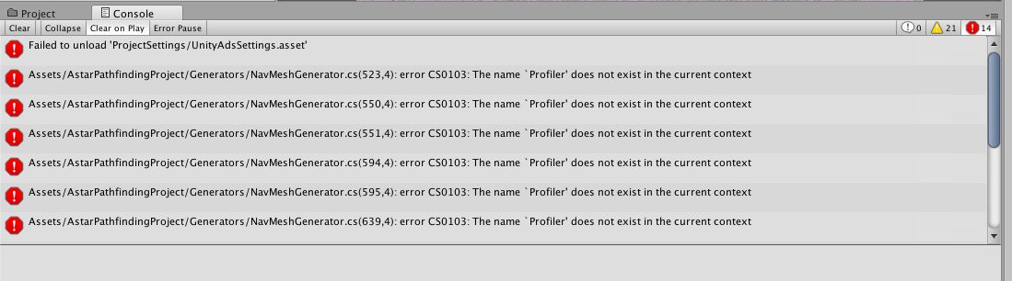
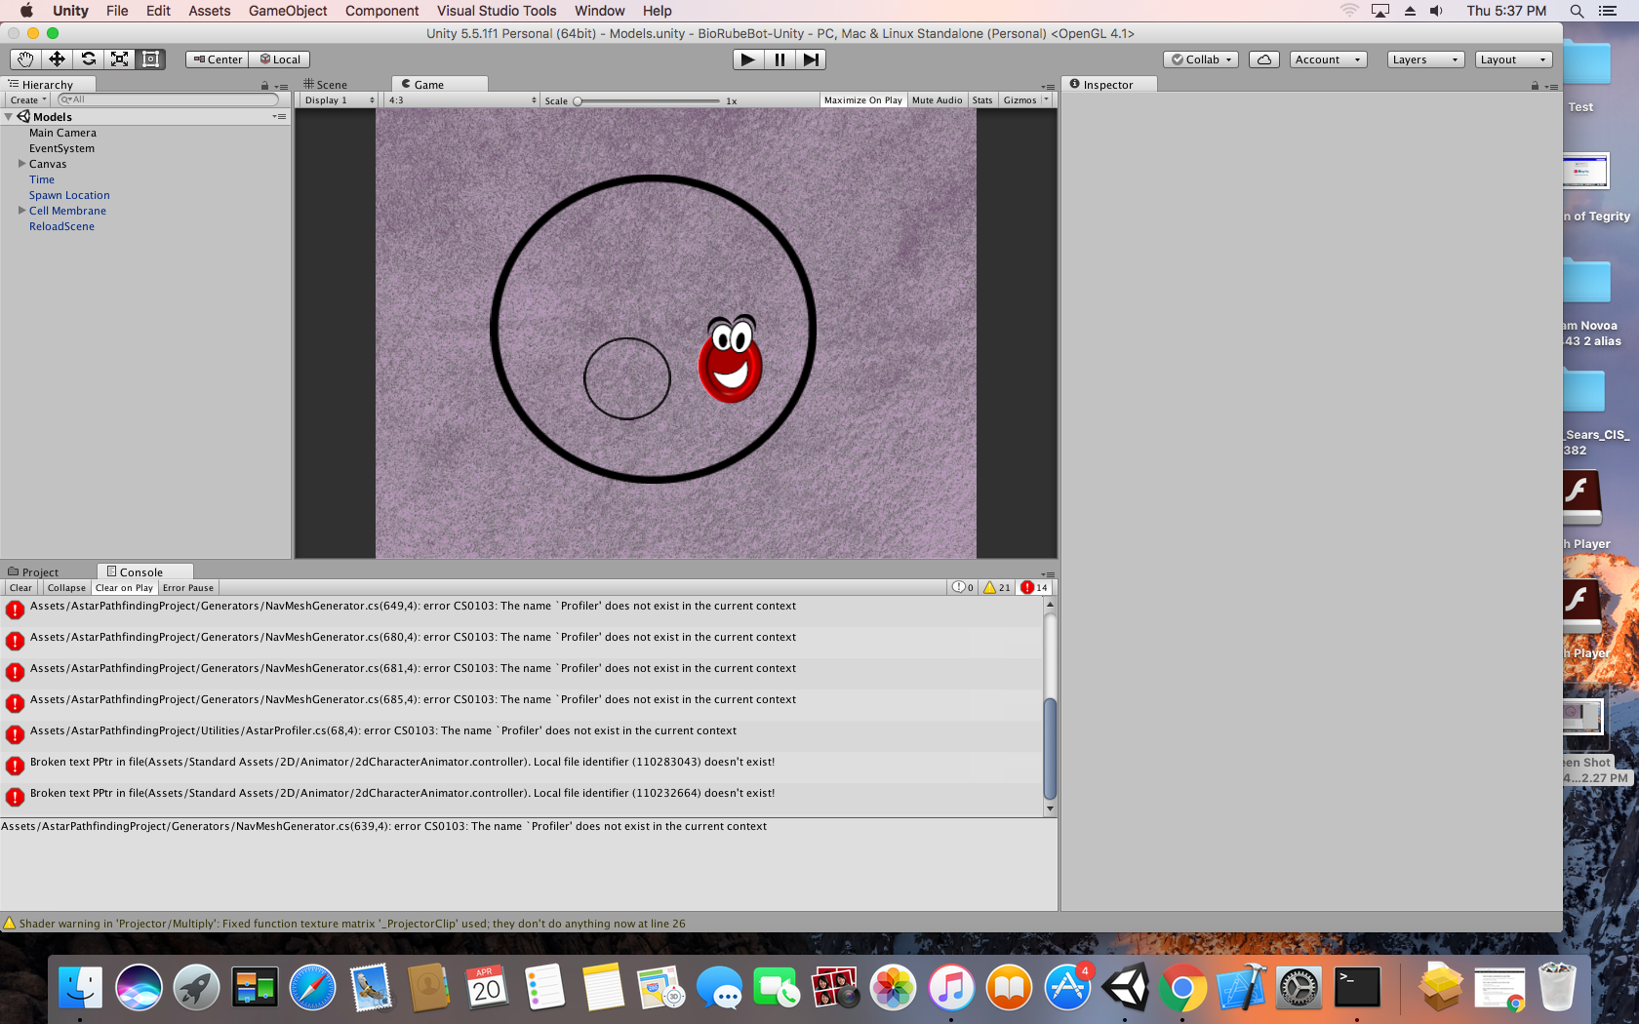
Demonstration
Notes:
Denzel -This is what we started with. Start with the broke ipad

Slide 10
Demonstration
Previous Version:
Contained functional level one
G-protein did not work correctly
Fast forward button did not work correctly
Very laggy
Latest Version:
Contains functional level one & two
Runs smoothly
All parts function as intended for both levels
Contains new pre-fabs for level three
Implemented fixes for Ipad
Notes:
Show different versions via ipad

Slide 11
Conclusions
BioRubeBot has made great strides
Functionality has been vastly improved
Refactored code for better efficiency and usability
Documentation has substantially been improved
Staged the project for future groups

Slide 12
Next steps
Finish pre-fabs for level 3
Complete level 3 by adding functionality to the prefabs
Convert scripts to interface with future objects with similar behavior
Add procedures for source control
Add procedures for installing applications on Ipad
Continue with detailed documentation for future groups
Maintain contact with customer
Notes:
Not just advise from us also from previous groups

Slide 13
Next steps
Advice for the group taking over this project:
Learn the biology behind the project.
learn C#: the language used to drive Unity.
Learn the Unity editor and how it works with the code that drives it.
Learn Git and source control.
Get Dr. Clines approval, she is very helpful and will be very clear with the direction of the project.

Slide 14

THANK YOU FOR YOUR TIME
Denzel Sears – Project lead
David Brosnan – Programming
Lisa George – Graphic Design
Daniel Hughes - Documentation
Notes:
Questions????????????????????????

